Slide 1




Agentic AI Training

Slide 2

Introduction to Agentic AI

Slide 3
5-Day Learning Journey: Program Overview

Slide 4
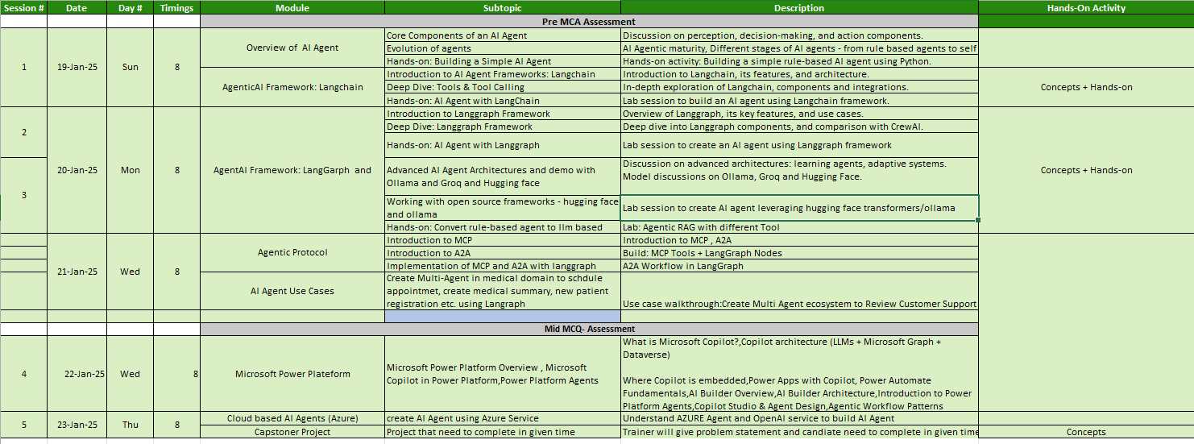

Slide 5


Harish Kumar
B.Tech (CSE) | MS in ML&AI
AWS Certified ML Specialist
1 yr Advanced certification in Generative AI
6+ yrs. Training experience in AI/GenAI/AWS
12+ IT experience in Banking, E-Commerce, Insurance etc .
Experienced Lead Data Scientist

Slide 6


Audience Introduction
Total Exp.
GenAI experienced:
Role: SE/QA/Lead/Manger

Slide 7

Agenda - Day1
Limitation of GenAI
Agentic AI foundation
Introduction to Langchain
Build Agent with Langchain

Slide 8
Generative AI
A subset of Artificial Intelligence (AI)
Enables machines to generate new, original content
Uses machine learning algorithms to create novel outputs
Can generate text, images, music, and more
Trained on large datasets to learn patterns and relationships
Notes:
it's a type of AI that enables machines to generate new, original content. This can be anything from text to images to music, and it's all made possible by machine learning algorithms and large datasets

Slide 9
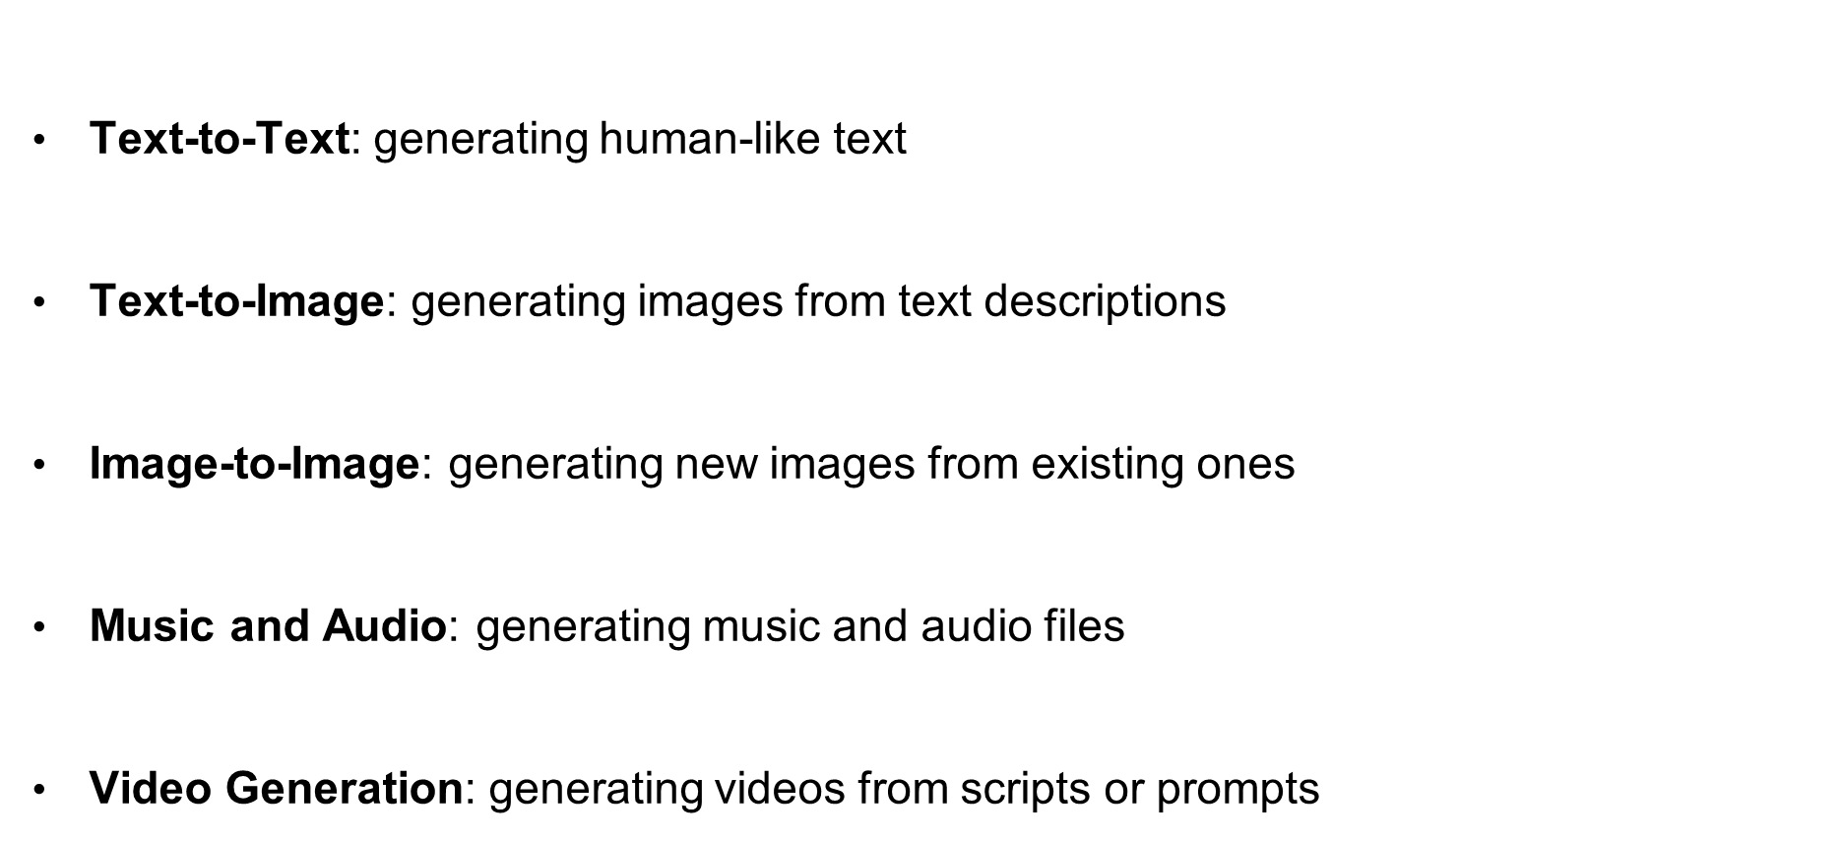
Types of GenAI
Notes:
From generating human-like text to creating new images and music, the possibilities are endless. Each type of GenAI has its own unique applications and use cases.

Slide 10
Limitation of Gen AI
It generates responses based on prompts but doesn't autonomously pursue long-term objectives or complete tasks without continuous prompting.
Generative models usually lack persistent memory across sessions.
Generative AI struggles with multi-step reasoning or breaking down complex tasks
Generative AI doesn’t interact with external tools or systems (APIs, databases, web browsers) unless explicitly connected.
ChatGPT or other LLMs just respond to prompts — no looped execution or self-initiated action.
Generative AI is a single-agent model, not designed for coordination between multiple AI entities.
LLMs may hallucinate but don’t typically verify or improve their answers over time.

Slide 11
Traditional LLM vs Agentic LLM
Feature | Traditional LLM | Agentic LLM
Response Type | Static answers | Dynamic actions
Memory | No memory (stateless) | Persistent memory
Capabilities | No tools | Can call tools/APIs
Reasoning | No planning | Creates step-by-step plans

Slide 12

AI Agents
AI agent is an autonomous entity capable of perceiving its environment, making decisions, and taking actions to achieve specific goals. Agents can vary in complexity from simple reactive agents that respond to stimuli to more advanced intelligent agents that learn and adapt over time.
Types of agents include:
Reactive Agents: Respond directly to environmental changes without internal memory.
Model-Based Agents: Use internal models of the world to make decisions.
Goal-Based Agents: Plan actions based on achieving specific goals.
Utility-Based Agents: Evaluate potential actions based on a utility function to maximize outcomes.

Slide 13
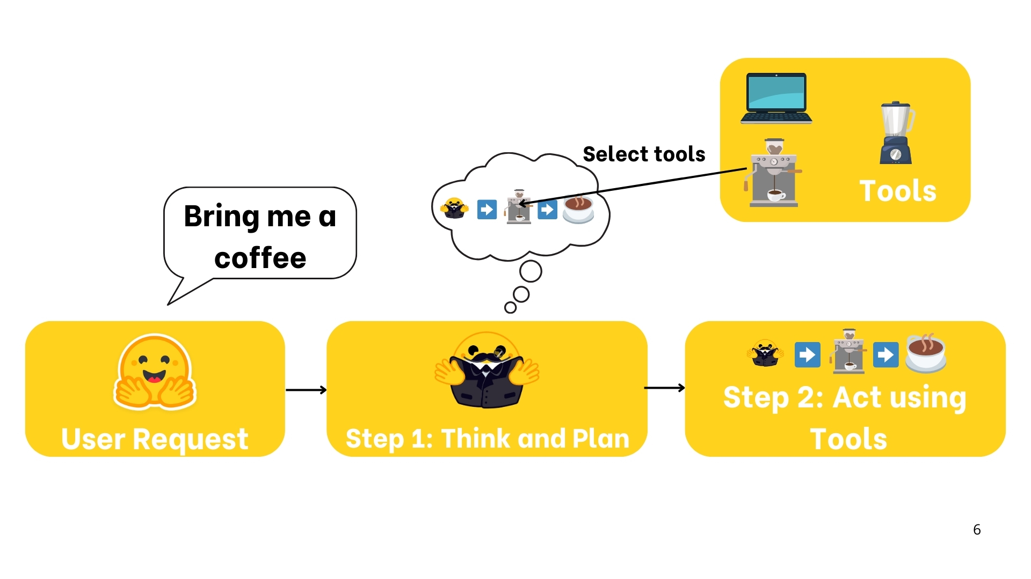
What is AI Agent

Slide 14








Agent Capabilities
Perception
Reasoning
Action
Memory
Input understanding.
LLM or rule-based logic.
Tool execution.
Short-term + Long-term.

Slide 15
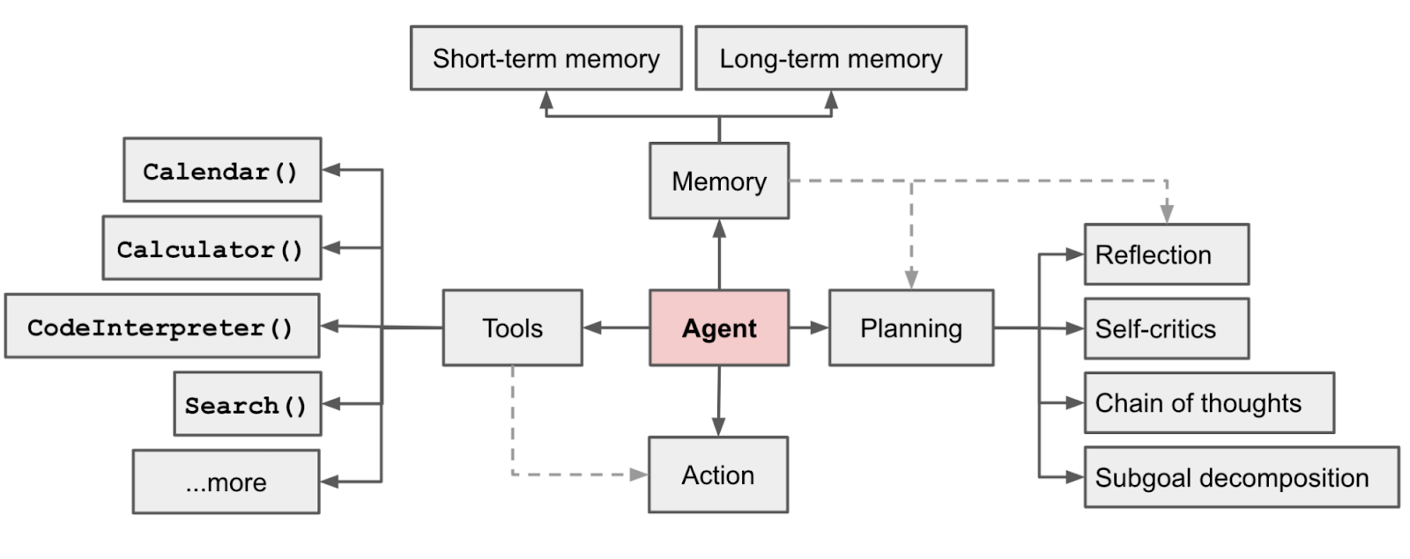
Agent
Source: https://lilianweng.github.io/posts/2023-06-23-agent/

Slide 16
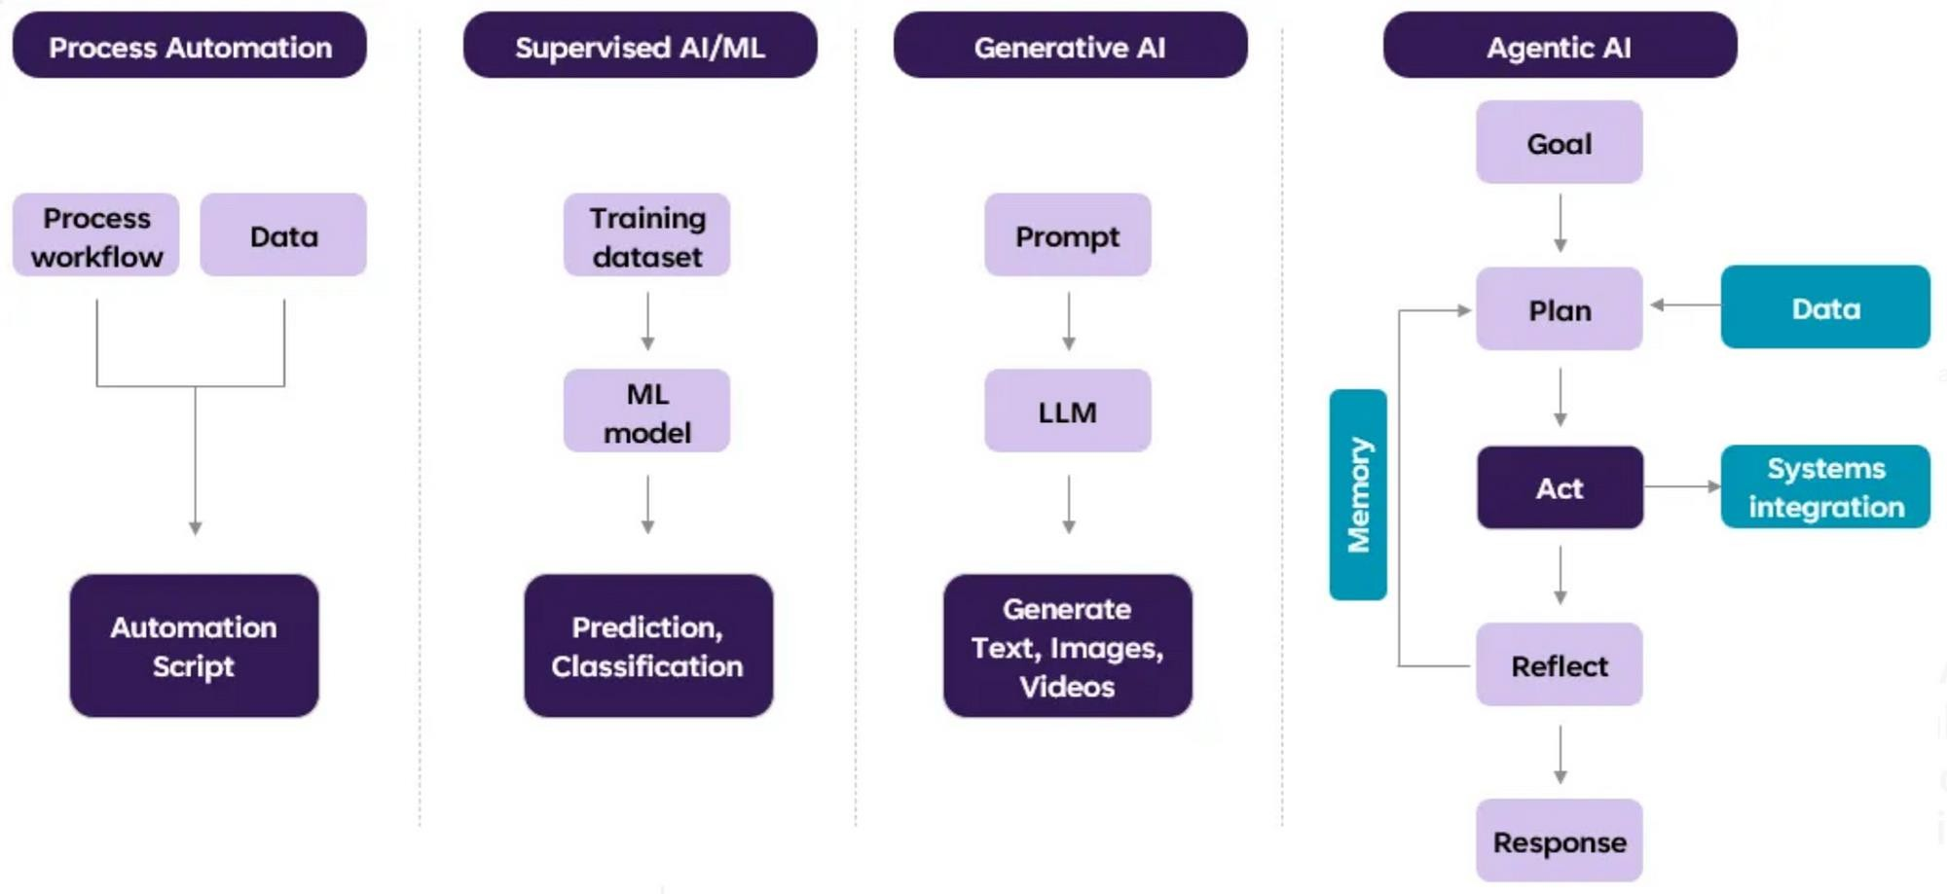
Agentic AI Evolution

Slide 17

Key Characteristics of AI Agent
1
Goal-Oriented
2
Autonomous
AI Agent systems are designed with specific goals in mind, driving their actions and decisions.
They can operate independently, making decisions and taking actions without constant human intervention.
3
Self-Learning
4
Contextual Awareness
AI Agent continuously learns and improves its performance based on data and feedback.
They can understand and adapt to changing contexts, making decisions based on real-time information.

Slide 18

Use cases
Customer Service
Automated chatbots handling initial customer inquiries
Virtual assistants providing 24/7 support
AI agents resolving common issues without human intervention
Personal Productivity
Digital assistants managing calendars and scheduling
Email sorting and prioritization agents
Task management systems with intelligent recommendations
Healthcare
Diagnostic support agents analyzing patient symptoms
Medication management assistants for patients
Administrative agents handling appointment scheduling and records
Financial Services
Robo-advisors managing investment portfolios
Fraud detection agents monitoring transactions
Insurance claim processing automation

Slide 19
Use cases
Sales and Marketing
Lead qualification and scoring agents
Personalized product recommendation engines
Marketing automation tools optimizing campaigns
Manufacturing and Supply Chain
Predictive maintenance agents monitoring equipment
Inventory optimization systems
Quality control agents detecting defects
Education
Tutoring agents providing personalized learning
Grading assistants evaluating assignments
Course recommendation agents suggesting appropriate classes
Home Automation
Smart home assistants controlling devices and systems
Security monitoring agents detecting unusual activity
Energy optimization agents managing consumption

Slide 20
When to use agents / When to avoid them
Task
You want to build a system that automatically collects product reviews from competitor websites, analyzes sentiment, extracts feature requests, and emails a summary to the product team every Monday.
Solution Using an AI Agent
An AI Agent is a good fit because the task is:
Goal-driven: "Get weekly insights from competitor reviews"
Multi-step: Browse → Scrape → Analyze → Summarize → Email
Tool-based: Needs access to browser tools, NLP libraries, and email API
Autonomous: Should run weekly without manual intervention
Example Workflow for the Agent:
Web Scraper Tool: Extracts latest reviews from competitor websites.
Sentiment Analyzer (NLP pipeline): Analyzes each review.
LLM Tool: Extracts key themes, complaints, and feature requests.
Summarizer: Generates a weekly insights report.
Email Tool: Sends the report to a Slack channel or email inbox.
Agent Advantages:
Can adapt if some pages fail or URLs change.
Can log errors and retry steps.
Can evolve over time with feedback and memory.

Slide 21
When Not to Use an AI Agent
If the task was simpler, like: "Summarize a block of text and send it via email",
A Generative AI prompt + API script would be more efficient. You can:
Paste the reviews manually.
Use a single GPT prompt to summarize them.
Trigger an email function.
Why Not an Agent?
No need for autonomy or adaptive planning.
Simpler, faster, and cheaper to do in one shot.
Easier to debug and deploy.

Slide 22
Build An Agent

Slide 23
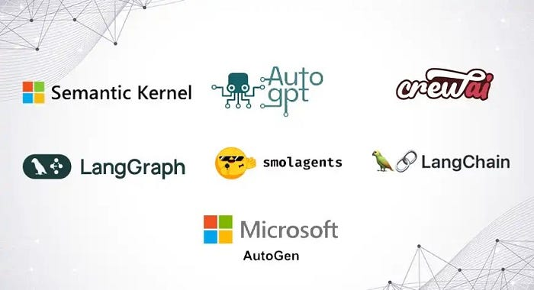
Agentic Framework

Slide 24




Frameworks
Framework | Language | Description | Best For
LangGraph | Python, Javascript | A graph-based framework built on top of LangChain, designed to coordinate multiple agents and tools with memory. | Structured agent workflows with LLMs.
CrewAI | Python | Simple and intuitive agent orchestration framework for teams of LLM agents. Uses a “Crew” and “Agent” model with roles and goals. | Task-oriented multi-agent collaboration.
AutoGen | Python | Microsoft’s framework for building LLM-powered agents that communicate via messaging. Supports human-AI and AI-AI collaboration. | Multi-agent chat and complex interactions.
AgentVerse | Python | Designed for simulating and evaluating large numbers of agents. Ideal for research on collective behaviors. | Multi-agent simulations and social dynamics.
OpenAgents | Python | Open-source project combining LangChain, FastAPI, and other tools. Allows UI integration and multi-agent task execution. | Developer-friendly agent apps.
MiniAGI | Python | Lightweight framework for building LLM-based agents using memory, tools, and recursive reasoning. | Quick experimentation with agents.
MetaGPT | Python | Treats AI agents like team members in a software company (e.g., PM, engineer, QA). Modular and production-oriented. | Building software with agent teams.

Slide 25
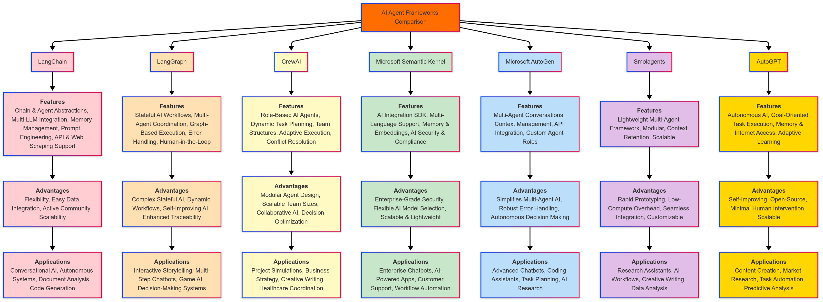
AI Agents Framework Comparison

Slide 26
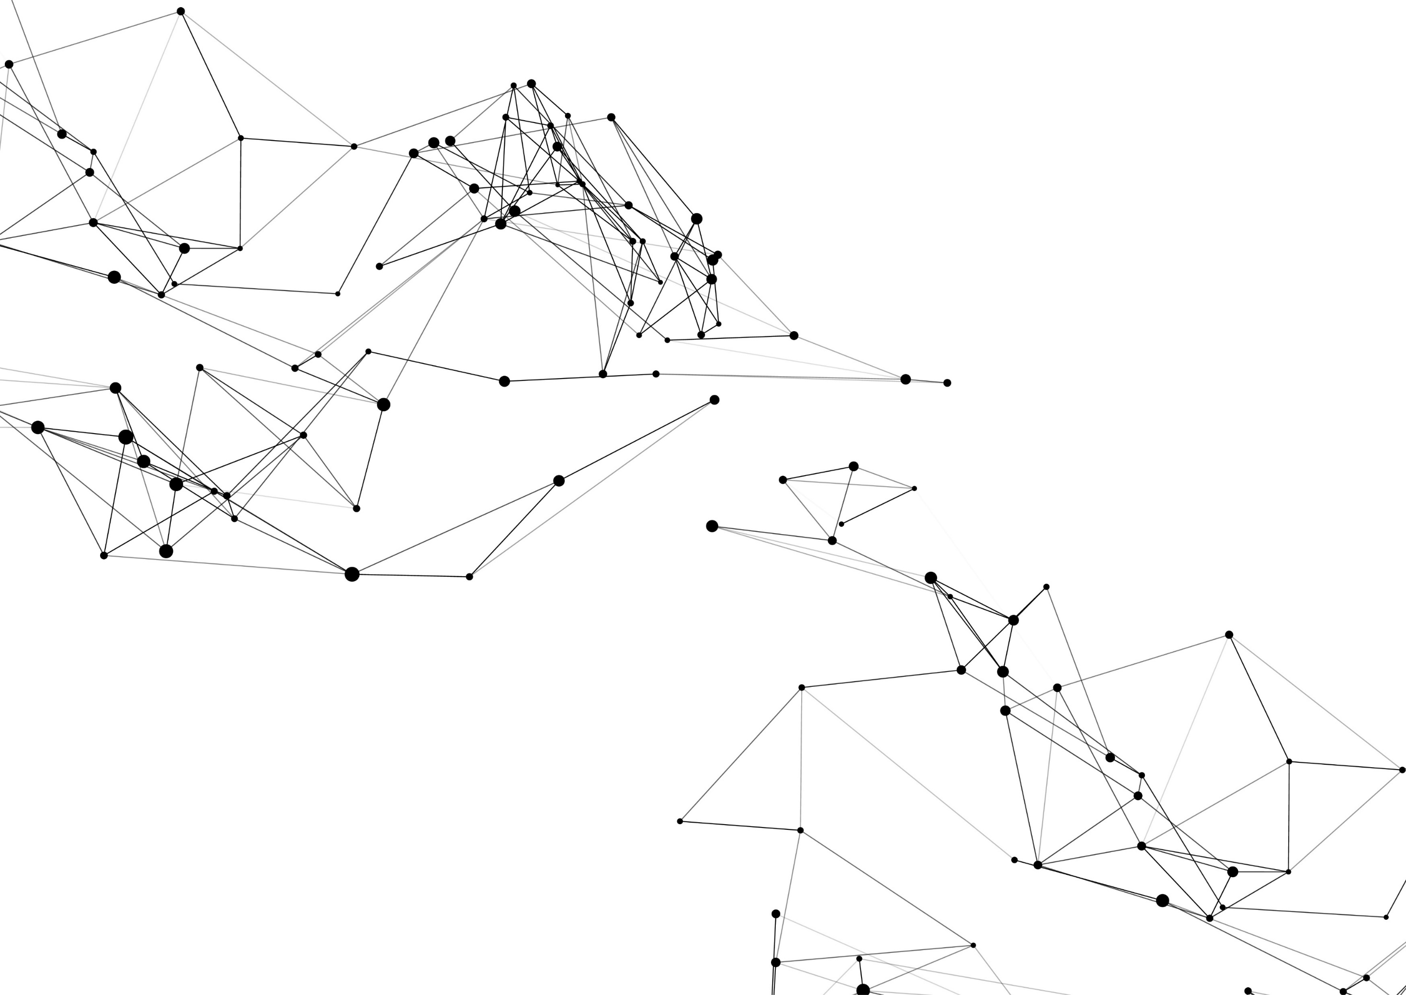
DEMO

Slide 27
AI Agent Pattern
Agent patterns in AI refer to design approaches that enable AI systems to act more autonomously and intelligently.
These patterns, like Reflection, Tool Use, Planning, and Multi-Agent Collaboration, empower AI to reason, plan, execute tasks, and learn from their actions, mimicking human-like problem-solving capabilities.

Slide 28
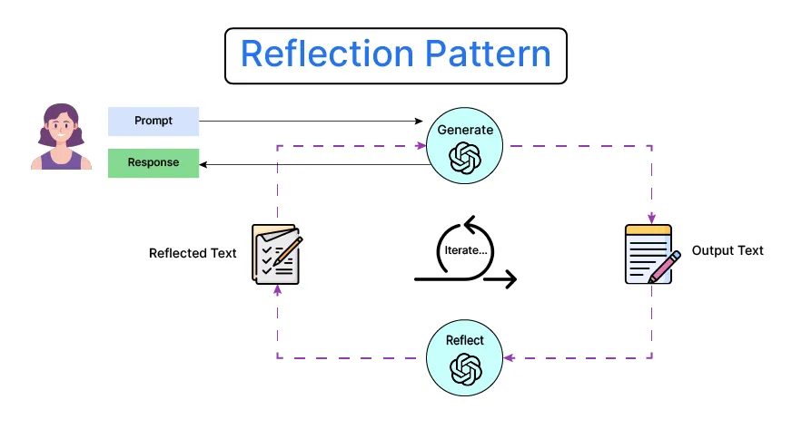
Reflection Pattern
The Reflection Pattern enables an AI agent to pause and evaluate its current progress, strategy, and understanding. It often involves meta-cognition—thinking about what has been done and what needs to be adjusted to reach a goal more efficiently.
Encourages introspection and self-evaluation.
Useful for complex or multi-step tasks.
Helps identify errors and improve reasoning.
Often implemented via checkpoints or "thought loops".
Can be combined with memory modules for deeper reasoning.

Slide 29
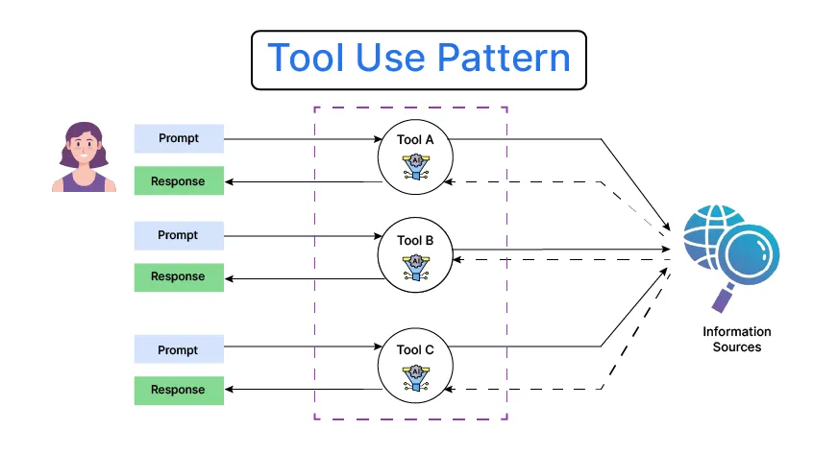
Tool Use Pattern
The Tool Use Pattern allows agents to call upon external APIs, databases, calculators, or plugins to extend their capabilities beyond native reasoning. This empowers agents to handle a wider range of tasks effectively.
Agent invokes tools like search engines, calculators, or code interpreters.
Enables solving tasks beyond language-only capabilities.
Often implemented in frameworks like LangChain or ReAct.
Requires mechanisms for selecting and invoking tools dynamically.
Important for real-world applications like retrieval-augmented generation (RAG).

Slide 30
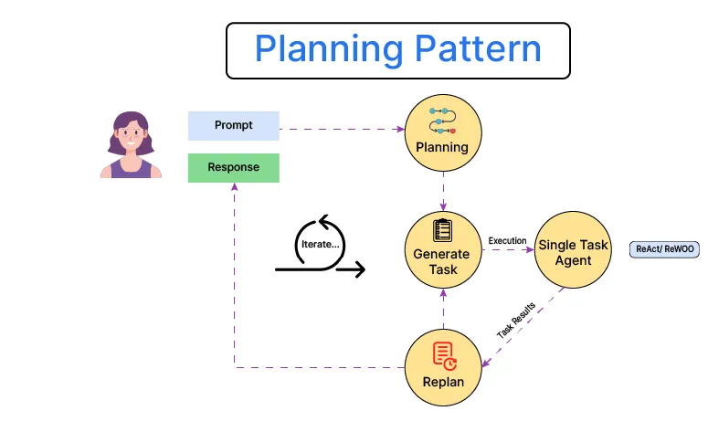
Planning pattern
The Planning Pattern involves creating a step-by-step plan before executing actions. This structure ensures logical task progression, especially for multi-step or high-stakes tasks requiring accuracy.
Agent outlines goals and subgoals in advance.
Reduces trial-and-error and improves efficiency.
Useful for code generation, reasoning, and long documents.
Often uses a planner-executor model.
Enhances transparency and traceability in agent behavior.

Slide 31
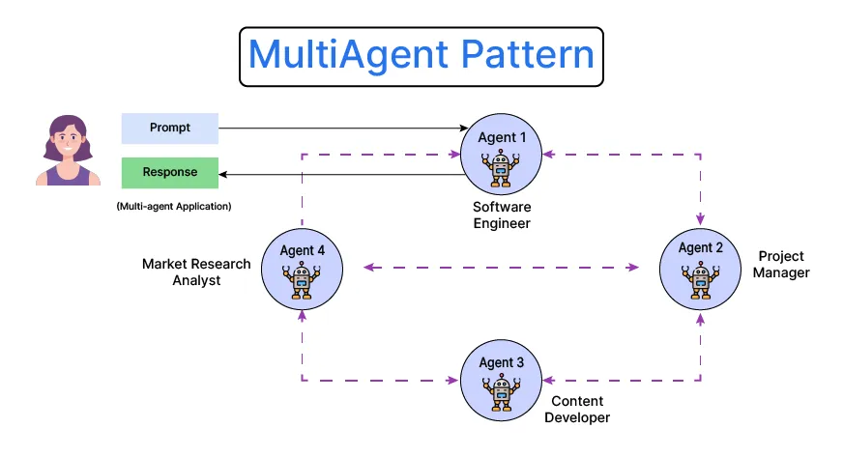
Multi-agent pattern
The Multi-Agent Pattern distributes a task across multiple specialized agents, each responsible for a specific role. These agents can collaborate, compete, or coordinate, enabling more scalable and modular solutions.
Supports parallelism and specialization.
Agents can be role-based (e.g., writer, reviewer, executor).
Encourages emergent behavior and coordination.
Ideal for complex tasks like research, code review, or game playing.
Can integrate with human feedback or supervisor agents.

Slide 32
Patterns
Each pattern offers unique strengths for building intelligent systems. Depending on task complexity, environment, and goals, one or more patterns can be combined for optimal performance.
Pattern | Strengths | Best For
Reflection | Improves self-awareness and adaptability | Debugging, strategy adjustment
Tool Use | Extends capabilities via external tools | Math, retrieval, real-world tasks
Planning | Provides structure and foresight | Multi-step reasoning, code generation
Multi-Agent | Enables collaboration and modularity | Complex, distributed task environments

Slide 33
What is Agentic AI?
Agentic AI is an artificial intelligence system that can accomplish a specific goal with limited supervision. It consists of AI agents—machine learning models that mimic human decision-making to solve problems in real time. In a multiagent system, each agent performs a specific subtask required to reach the goal and their efforts are coordinated through AI orchestration.
Unlike traditional AI models, which operate within predefined constraints and require human intervention, agentic AI exhibits autonomy, goal-driven behavior and adaptability. The term “agentic” refers to these models’ agency, or, their capacity to act independently and purposefully.
Agentic AI builds on generative AI (gen AI) techniques by using large language models (LLMs) to function in dynamic environments. While generative models focus on creating content based on learned patterns, agentic AI extends this capability by applying generative outputs toward specific goals. A generative AI model like OpenAI’s ChatGPT might produce text, images or code, but an agentic AI system can use that generated content to complete complex tasks autonomously by calling external tools. Agents can, for example, not only tell you the best time to climb Mt. Everest given your work schedule, it can also book you a flight and a hotel.

Slide 34
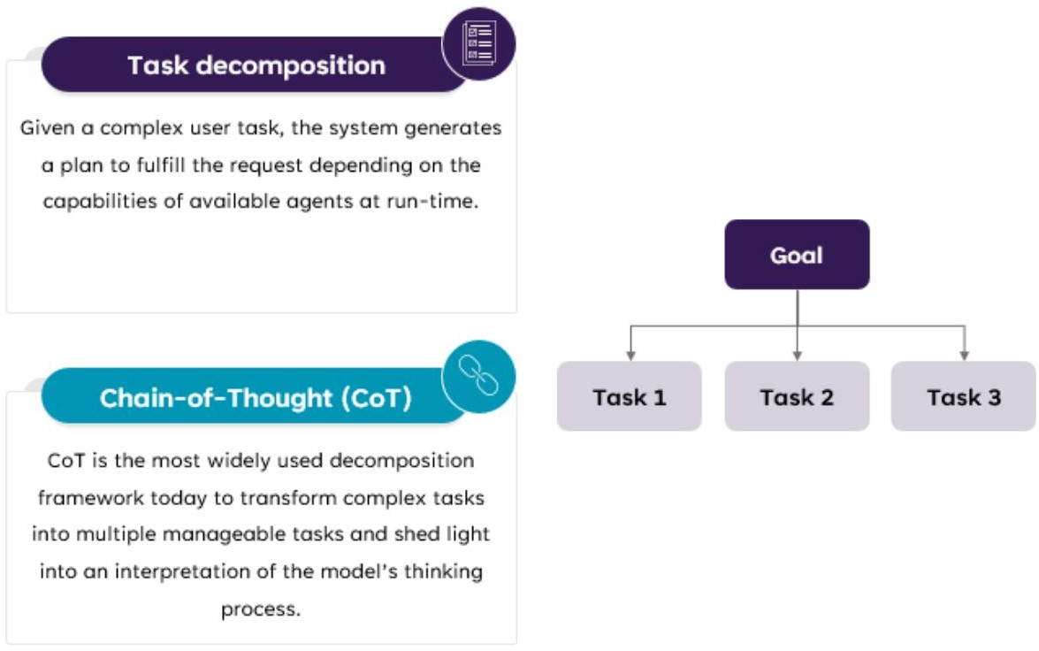
Agentic AI capabilities – Task Decomposition

Slide 35
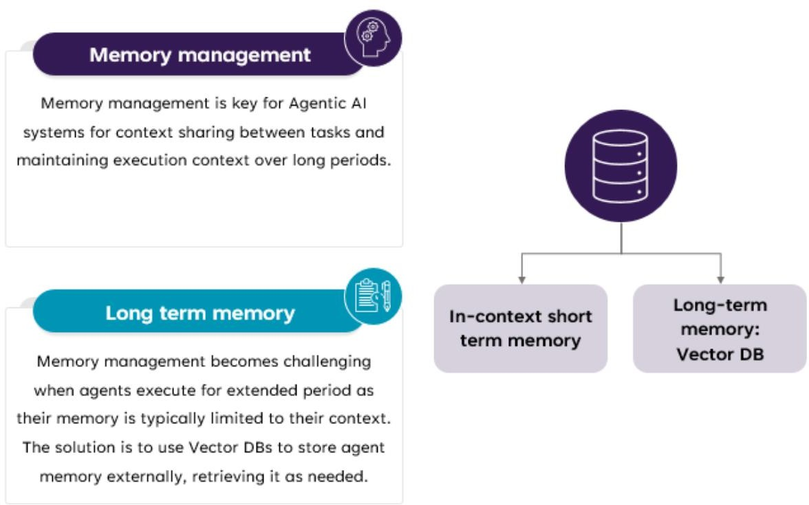
Agentic AI capabilities – Memory Management

Slide 36
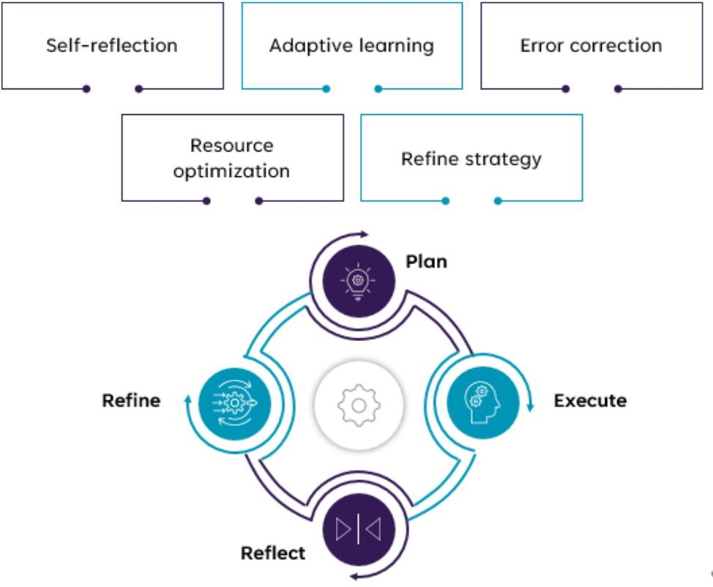
Agentic AI capabilities – Reflect & Adapt

Slide 37
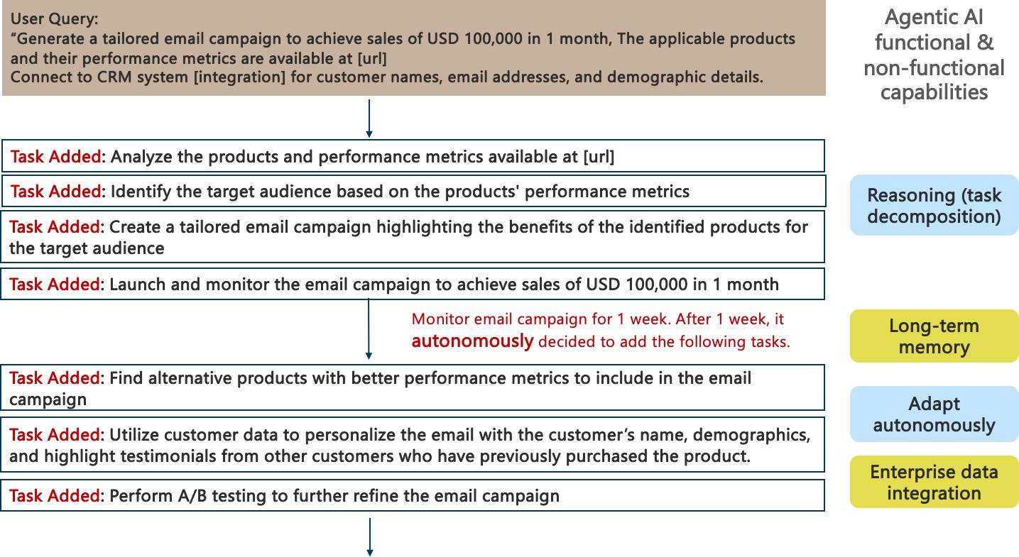
Agentic AI Use-case: Funds Email Marketing Campaign

Slide 38
Agentic AI Reference Architecture

Slide 39
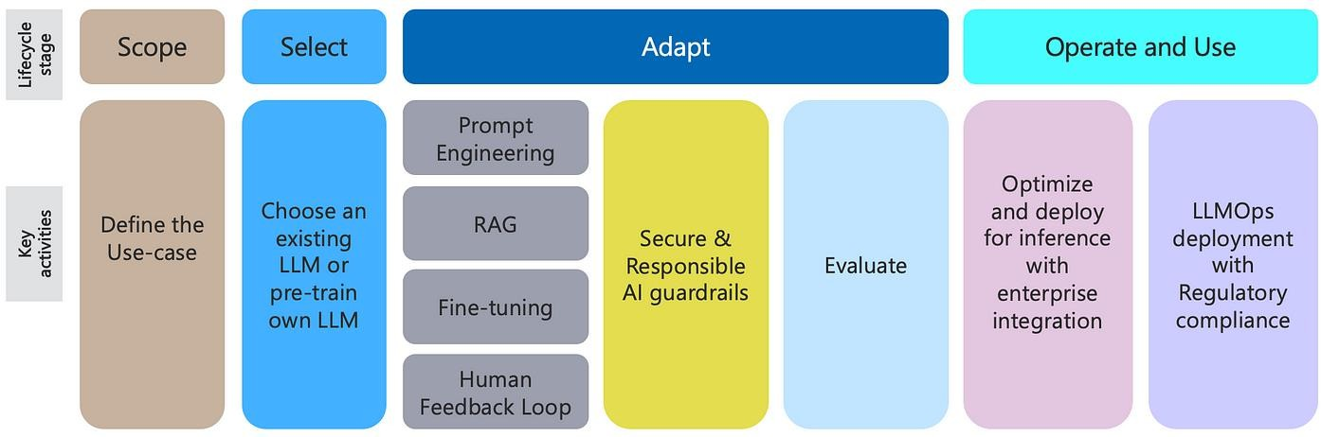
Generative AI Lifecycle

Slide 40
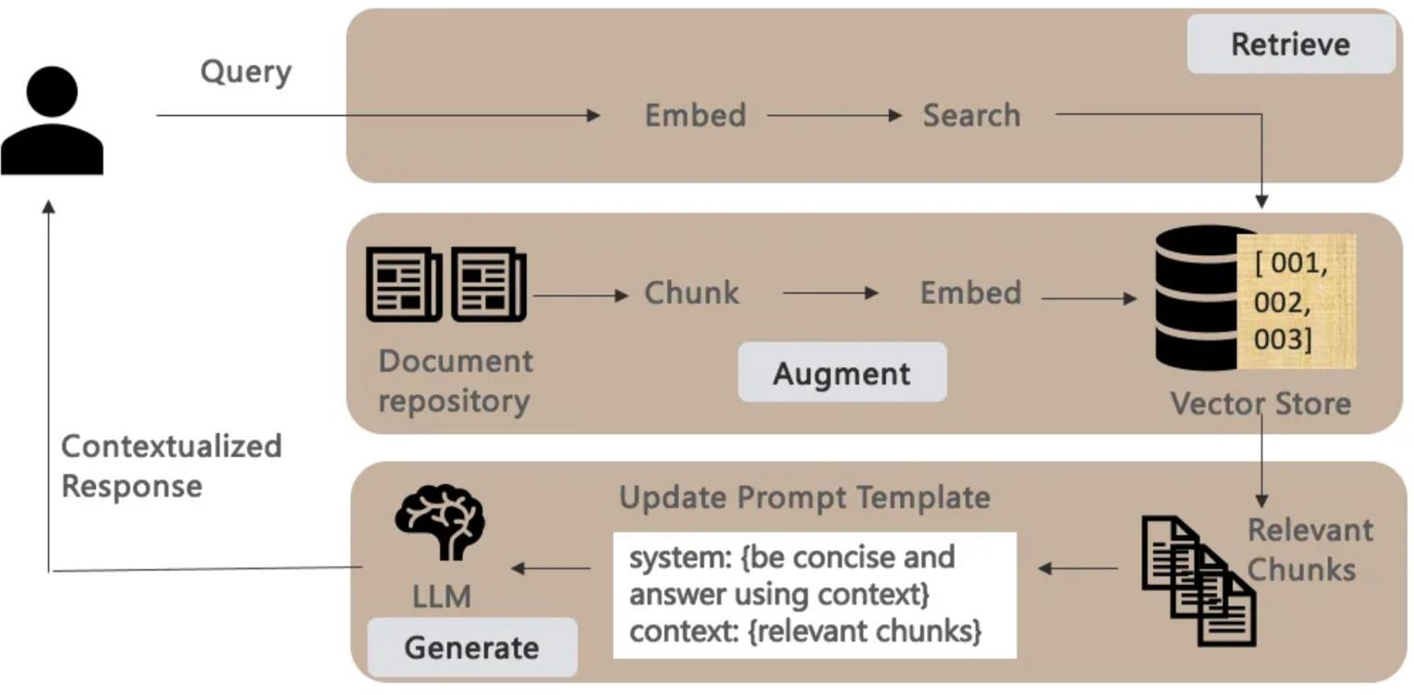
Gen AI Architecture Patterns – Retrieval-Augmented- Generation (RAG)
Fine-tuning is a computationally intensive process. RAG provides a viable alternative by providing additional context with the prompts — grounding the retrieval / responses to the given context.
Given a user query, a RAG pipeline literally consists of
the 3 phases below:
Retrieve: Transform user queries to embeddings to
compare its similarity score with other content.
Augment: with search results / context retrieved from a vector store that is kept current and in sync with the underlying document repository.
Generate: contextualized responses by making
retrieved chunks part of the prompt template that provides additional context to the LLM on how to answer the query.

Slide 41
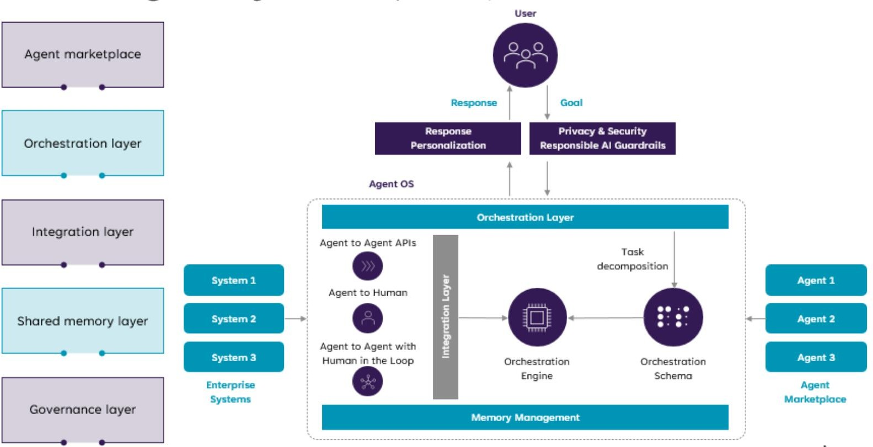
Agentic AI Platform Reference Architecture
The future where enterprises will be able to develop new Enterprise AI Apps by orchestrating / composing multiple existing AI Agents.
* D. Biswas. Stateful Monitoring and Responsible Deployment of AI Agents. 17th International Conference on Agents and Artificial Intelligence (ICAART), 2025 ( link)

Slide 42
Agentic AI Scenarios
Agentic RAGs
Reinforcement
Learning Agents

Slide 43
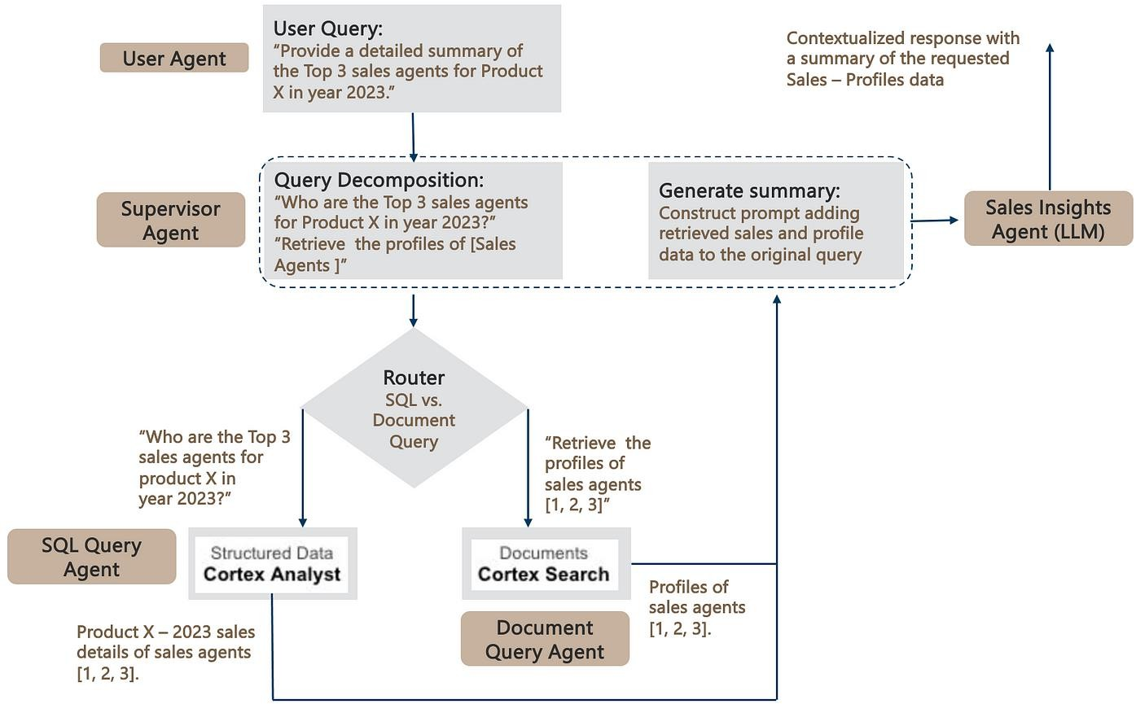
Agentic RAGs: Extending RAGs to SQL Databases
Agentic AI framework to build RAG pipelines that work seamlessly over both structured and unstructured data stored in Snowflake.
The SQL & Document query agents leverage the respective Snowflake Cortex Analyst and Search components detailed earlier to query the underlying SQL and Document repositories.
Finally, to complete the RAG pipeline, the retrieved data is added to the original prompt — leading the generation of a contextualized response.
* D. Biswas. Agentic RAGs: extending RAGs to SQL Databases. AI Advances, 2024 (link)

Slide 44
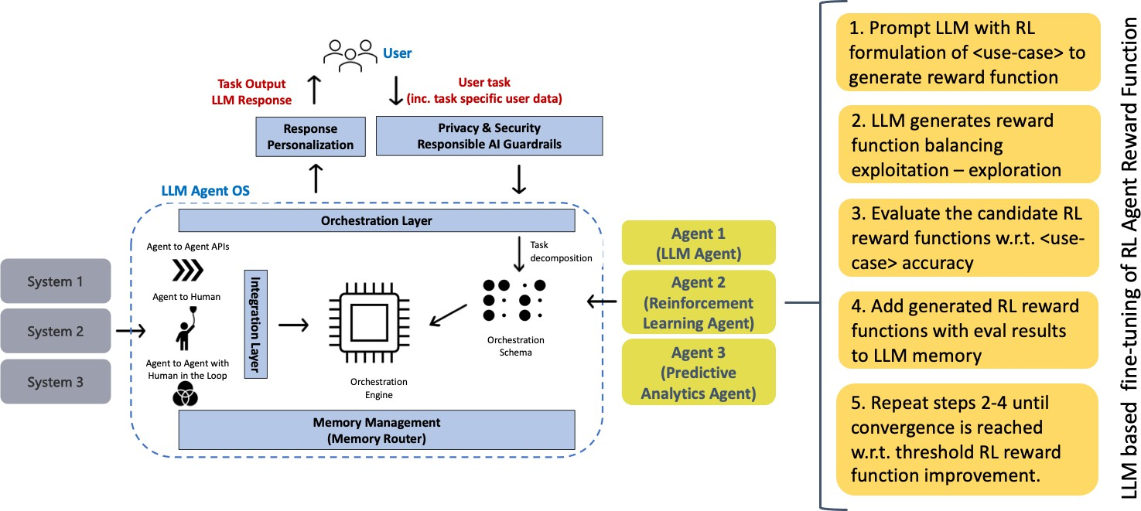
Reinforcement Learning Agents
When we talk about AI agents today, we mostly talk about LLM agents, which loosely translates to invoking (prompting) an LLM to perform natural language processing (NLP) tasks
Some agentic tasks might be better suited to other ML techniques, e.g., Reinforcement Learning (RL), predictive analytics, etc. — depending on the use-case objectives.
* D. Biswas. LLM based fine-tuning of Reinforcement Learning Agents. AI Advances, 2024 (link)

Slide 45
DEMO

Slide 46
Agentic AI: A2A & MCP — Concepts, Mechanisms & Use Cases
Notes:
Be specific and direct in the title. Use the subtitle to give the specific context of the speech.
-The goal should be to capture the audience’s attention which can be done with a quote, a startling statistic, or fact. It is not necessary to include this attention getter on the slide.

Slide 47
Agentic AI: A2A & MCP — Concepts, Mechanisms & Use Cases
Agenda / What We Will Cover
What is Agentic AI & why protocols matter
A2A (Agent-to-Agent) — theory, interaction types, message passing, coordination & negotiation
MCP (Model Context Protocol) — what it is, how it standardizes tool/data access
Using A2A and MCP together — how they complement each other
Example Scenario: end-to-end workflow using A2A + MCP
Summary & Key Takeaways
Notes:
Use the background points to post details that are not common knowledge, or that the audience will need to understand the context of the speech.
-Do not read these main points from the PowerPoint, instead elaborate on these points during the speech.

Slide 48

Why Protocols are Important for Agentic AI
Notes:
The counterargument should be the most common argument against the topic. The goal for this slide is to address the counterargument in such a way as to actually strengthen the original topic. Be sure to address each piece of evidence against the topic. As you address each piece of evidence elaborate on the text found on the slide. Remember to transition to the final slide, the action step.

Slide 49



Remote
Hotel Agent
What Can it do?
Send?
Response?
Communicate?
Personal Agent
Communicate?
Car Rental Agent
What Can it do?
Send?
Response?
Client
Communicate?
Remote

Slide 50
Core Architectural Components
The Agent2Agent protocol consists of several building blocks for agent interactions:
A2A client
Agent card
Task
Message
Artifact
Part
A2A server
Notes:
The counterargument should be the most common argument against the topic. The goal for this slide is to address the counterargument in such a way as to actually strengthen the original topic. Be sure to address each piece of evidence against the topic. As you address each piece of evidence elaborate on the text found on the slide. Remember to transition to the final slide, the action step.

Slide 51
A2A client
Agent card
Task
A2A server
The A2A client, also known as the client agent, can be an app, service or other AI agent that delegates requests to remote agents. It uses the Agent2Agent protocol to initiate communication.
The A2A server, also called the remote agent, takes requests, processes tasks and responds with status updates or results. It exposes an HTTP endpoint that’s compatible with the Agent2Agent protocol.
This JSON file outlines agentic AI metadata and can be accessed using a URL. It contains basic information about an agent, including its name, description, version, service endpoint URL, supported modalities or data types and authentication requirements.
A task represents a unit of work needed to accomplish a request. It has a unique ID and progresses through a lifecycle of defined states (submitted, working, input-required, completed, failed). Tasks are useful for multi-turn processing or long-running agent-to-agent collaboration.

Slide 52
Message
Artifact
Part
As a fundamental unit of communication, a message depicts a single exchange or turn in a conversation. It contains one or more parts holding the actual content.
Messages relay answers, context, instructions, prompts, questions, replies and status updates.
An artifact is a tangible product generated by the A2A server as a result of its work. It can be a document, image, spreadsheet or any other deliverable. Like messages, artifacts consist of one or more parts and can be incrementally streamed.
A part is a piece of content inside a message or an artifact. Parts have various types based on the data they carry. A TextPart is a vessel for text, a FilePart represents files and a DataPart encompasses structured JSON (JavaScript Object Notation) data.

Slide 53
A2A (Agent-to-Agent) Protocol
Notes:
Dedicate this entire slide to the thesis statement. It is the reason the speech is being given. Use this time to reveal the three main points of the speech (slides 4,5,6) as an overview for the direction of the speech:
-[type main point #1 here]
-[type main point #2 here]
-[type main point #3 here]
Be sure to transition to the first main point and the next slide.

Slide 54
What is A2A (Agent2Agent)
The Agent2Agent (A2A) protocol is a communication protocol for artificial intelligence (AI) agents, initially introduced by Google in April 2025. This open protocol is designed for multi-agent systems, allowing interoperability between AI agents from varied providers or those built using different AI agent frameworks.
Purpose: allow agents to discover each other, send tasks/messages, share outputs, coordinate workflows.
Works over standard channels (e.g. HTTPS + JSON-RPC / structured messaging) for secure, interoperable data exchange.
Notes:
The counterargument should be the most common argument against the topic. The goal for this slide is to address the counterargument in such a way as to actually strengthen the original topic. Be sure to address each piece of evidence against the topic. As you address each piece of evidence elaborate on the text found on the slide. Remember to transition to the final slide, the action step.

Slide 55
A2A Agent
Remote
Hotel Agent
Message
HTTPS
Personal Agent
What Can it do:
AgentCard
Communication:
Messages
Execution:
Agent Executor
A2A Agent
Car Rental Agent
Message
Client
HTTPS
Hotel_agent: localhost:1001
Car_rental_agent: localhost:1002
Remote

Slide 56
What is A2A (Agent2Agent)
Agent Card
agent.json
Name
Description
URL
Version
Default input/output mode
Skills: [ AgentSkill(
Id
Name
Descpription
Tags
Examples
)]
🤖 AI Assistant
🏨 Hotel Reservation Agent
💱 Currency Conversion Agent
🚌 Local Tours Agent
✈️ Flight Booking Agent

Slide 57
Message
{
role: “user”
parts: [{“type”: “text”,…}]
messageId: “123”
taskId: “ABC”
contextId: “xyz”
}
SendMessageSuccessResponse
{
id: str|int
result: message|task
}
Message
Task
{
role: “user”
parts: [{“type”: “text”,…}]
messageId: “123”
taskId: “ABC”
contextId: “xyz”
}
{
id: “user”
artifacts:
contextId: “xyz”
status: {
message: …
state: submitted|working| input_required|completed| canceled|failed
}
}

Slide 58
A2A Agent
Remote
Hotel Agent
Message
HTTPS
Personal Agent
What Can it do:
AgentCard
Communication:
Messages
Execution:
Agent Executor
A2A Agent
Car Rental Agent
Message
Client
HTTPS
Hotel_agent: localhost:1001
Car_rental_agent: localhost:1002
Remote

Slide 59
How A2A protocol Works
The A2A protocol follows a client-server model setup with a three-step workflow:
Discovery
Communication
Authentication

Slide 60
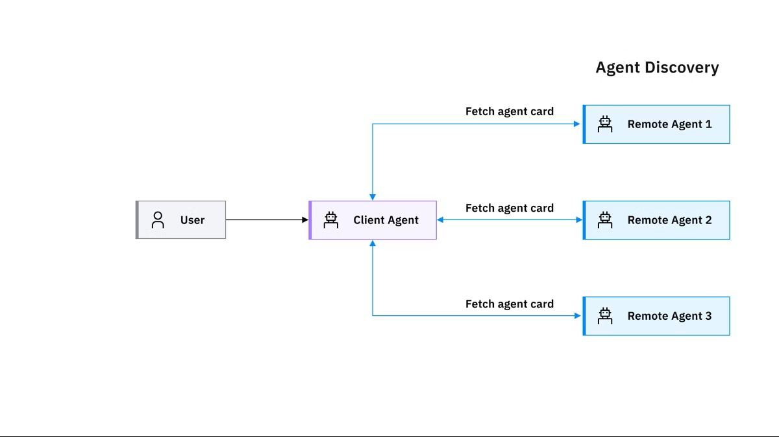
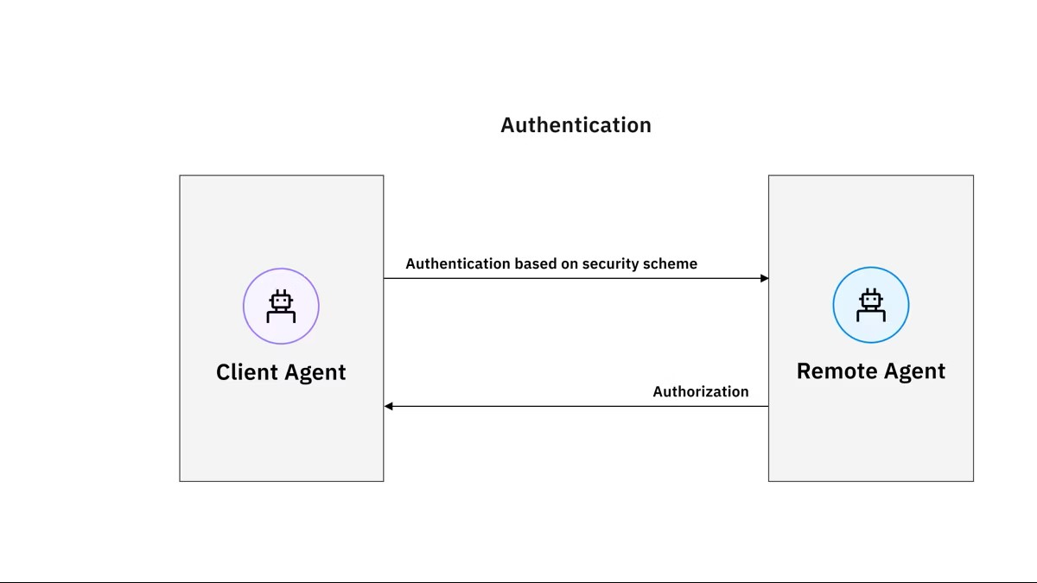
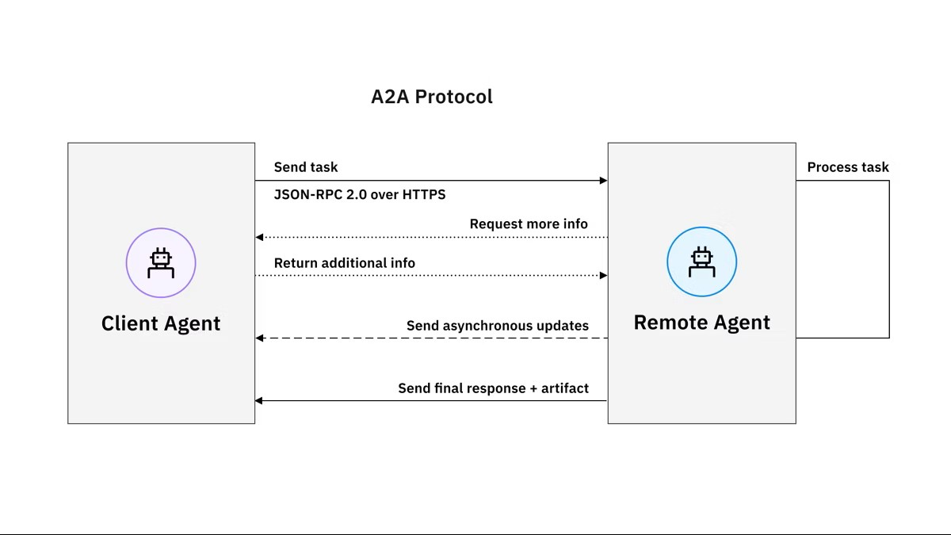
Authentication
Communication
Discovery

Slide 61
Discovery
Communication
Authentication

Slide 62
Discovery
Authentication
Communication

Slide 63
Agent Executor
Class ExampleAgentExecutor(AgentExecutor):
def __init__(self):
self.agent = ExampleAgent()
def execute(self, request, taskId, contextId,..):
TODO:
def cancel(self, request, taskId, contextId,..):
TODO:

Slide 64
Client
Example:
Get weather for delhi
Request
A2a Starlette Application/Server
Client Agent
agent_card
Weather Agent Executor
Weather Agent
RPC
Message
Message

Slide 65
Types of Agent Interactions under A2A
Task Delegation / Offloading: one agent gives a task to another specialized agent.
Collaboration / Parallel Processing: agents cooperate, each doing parts of a larger job (e.g. data-gathering, analysis, summarization).
Negotiation / Coordination: agents negotiate which one should do what, manage roles, split tasks intelligently for efficiency.
State / Context Sharing: agents share intermediate data, context, results, so downstream agents have what they need.

Slide 66
Why A2A Matters: Benefits & Use-Cases
Enables specialized agents (e.g. data-fetch agent, analysis agent, report-generator) to work together → modular & maintainable.
Task orchestration for complex, multi-step tasks that a single agent can’t handle reliably (e.g. research, automation, multi-domain tasks)
Interoperability: agents built with different frameworks/languages can still communicate via A2A — no lock-in.
Scalability & Flexibility: new agents can be added/removed without reworking the whole system — scalable architecture.
Privacy: The protocol treats agentic AI as opaque agents. So autonomous agents can collaborate without having to reveal their inner workings, such as internal memory, proprietary logic or particular tool implementations.
Seamless integration: A2A is built on established standards, including HTTP, JSON-RPC and SSE. This makes it easier for enterprises to adopt the protocol and helps ensure compatibility with their current technology stack.
Security: The Agent2Agent protocol is designed with security in mind. It supports enterprise-grade authentication and authorization mechanisms and allows for secure information exchange.

Slide 67
MCP (Model Context Protocol)

Slide 68
What is MCP (Model Context Protocol)
MCP is an open standard protocol introduced by Anthropic in late 2024 that defines a standard way for AI agents/LLMs to access external data, tools, and services.
It acts like a universal “connector” (some call it “USB-C for AI”) to plug models into any data source or tool, irrespective of tool or model provider.
MCP uses a client–server architecture: the agent (MCP client) sends requests to an MCP server which exposes tools, APIs, data sources, or context resources.

Slide 69
Use Case of MCP (With and without)
Use Case: GST Compliance & Financial Reconciliation System
Imagine a finance department where several agents handle tax calculations, invoicing, reconciliation and reporting. They’re meant to dance together, but without MCP they keep stepping on each other’s toes.
Problem Scenario (Without MCP)
A company has an internal multi-agent workflow:
Agent A: Reads invoices (PDF, CSV, ERP exports)
Agent B: Computes GST based on HSN/SAC codes
Agent C: Reconciles books with GSTR-2A/2B data
Agent D: Generates compliance reports

Slide 70
Use Case of MCP (With and without)
Where things break WITHOUT MCP
1. No standard interface for tax tools
Every agent uses its own style to call calculators or lookups:
Agent B expects HSN codes like "0401"
Agent C expects "4-digit-HSN"
Agent A extracts "HSN: 0401 Milk“
GST rate APIs return inconsistent structures. One uses "gstRate", another uses "rate".

Slide 71
Use Case of MCP (With and without)
Reconciliation agent cannot discover data sources
Agent C needs:
Vendor invoices
GSTR-2A summary
ITC eligibility rules
Without MCP, these “tools” are hidden behind custom wrappers.

Slide 72
Use Case of MCP (With and without)
Tight coupling makes updates dangerous
If GST rates change (which they do), every agent must be updated. Touch one file, three others break. Touch three, everything breaks.

Slide 73
How MCP Solves the Problem
MCP forces every tax-related tool to describe:
Input fields
Output fields
Data types
Validation schema

Slide 74
How MCP Solves the Problem
Dynamic discovery of tax tools
Agents ask MCP:
"What tax tools do we have today?“
MCP replies with a catalog:
invoice_reader_tool
gst_rate_lookup
reverse_charge_checker
gstr2a_fetcher
reconciliation_tool
itc_eligibility_engine

Slide 75
How MCP Solves the Problem
Dynamic discovery of tax tools
Agents ask MCP:
"What tax tools do we have today?“
MCP replies with a catalog:
invoice_reader_tool
gst_rate_lookup
reverse_charge_checker
gstr2a_fetcher
reconciliation_tool
itc_eligibility_engine
If tomorrow you add E-invoice validation or E-waybill generator, every agent instantly sees it.

Slide 76
How MCP Solves the Problem
Safe context sharing
MCP enforces well-defined formats.
Agents pass validated JSON structures.
None of the fields mysteriously change names like shape-shifting bureaucrats.
Agents only express intent
Agents don’t need to worry about:
GST rate changes
API keys
Authentication
New tax rules
Data source URLs

Slide 77
How MCP Solves the Problem
Aspect | Without MCP | With MCP
GST rate lookup | Hard-coded, inconsistent | Unified schema, auto-discovered
Invoice parsing | Each agent custom-coded | Single shared tool, consistent output
GSTR reconciliation | Manual wiring | Any agent can call reconciliation tool
Adding new compliance rules | Breaks existing agents | Instantly available
Data quality | Mutates unpredictably | Schema-validated, safe

Slide 78
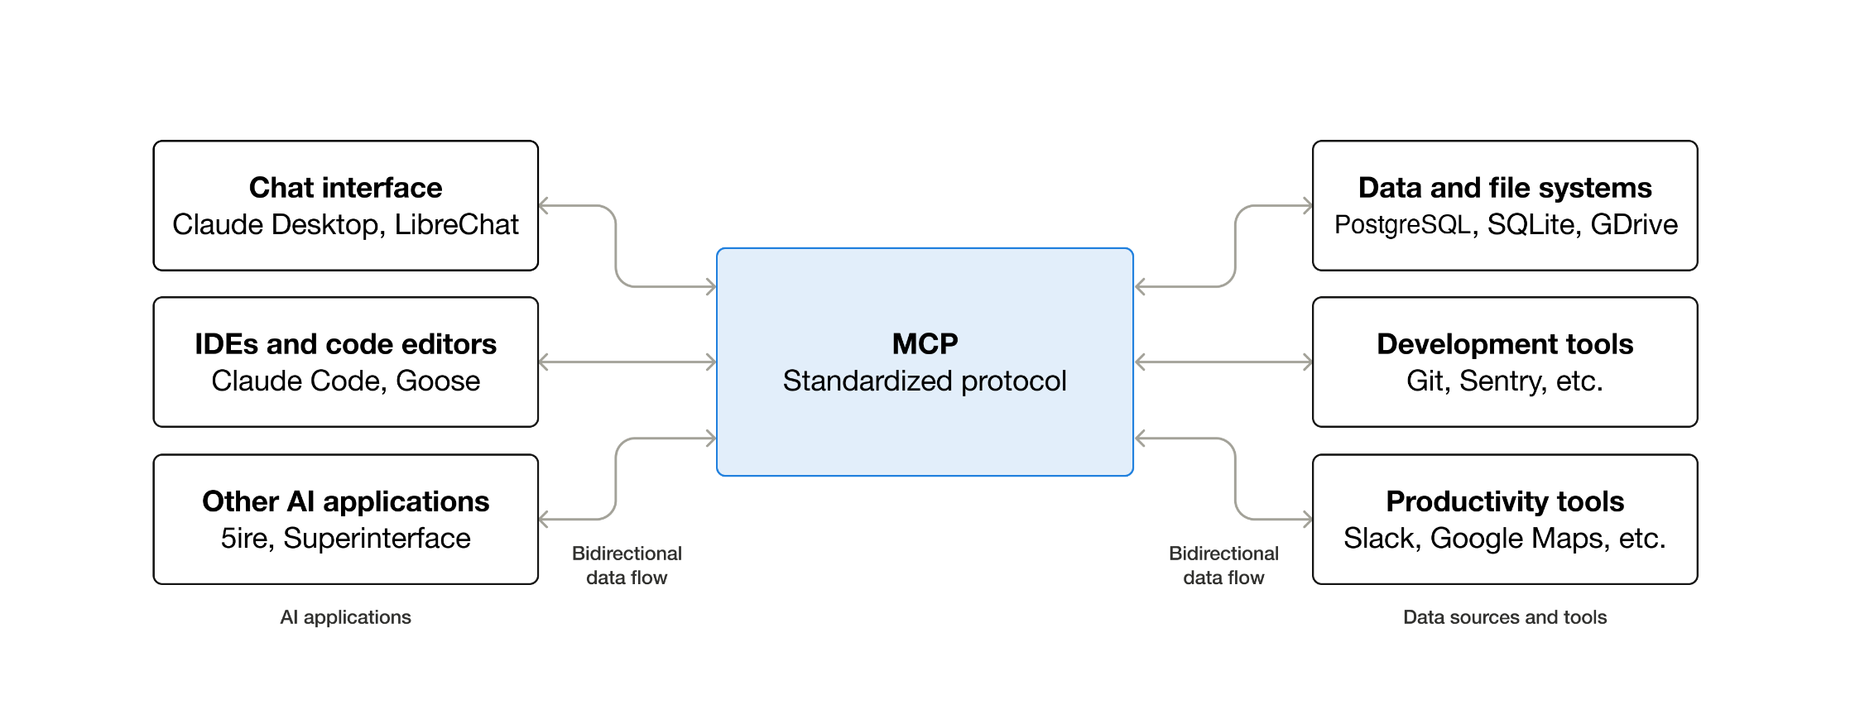
What is MCP (Model Context Protocol)

Slide 79
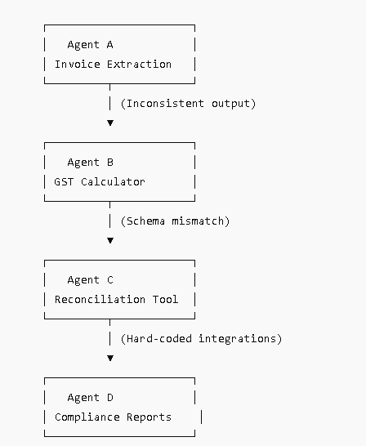
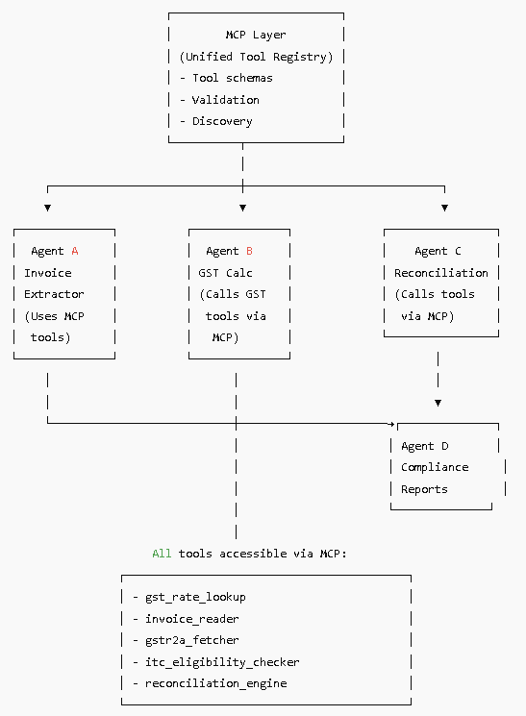

Slide 80
What MCP Enables: Tool & Data Integration
Allows LLM-based agents to fetch real-time data, access databases or APIs, read/write files, invoke external services, rather than relying only on pre-trained knowledge.
Standardizes calls: developers don’t need bespoke integration for each tool — one MCP connector works across many services.
Enables more powerful, context-aware AI agents: because agents can work with up-to-date external data, perform actions, and combine reasoning + tooling.

Slide 81
How MCP Works: Architecture
The MCP client/server model can be broken down into three key architectural components:
MCP host: An AI application receives the user requests and seeks access to context through the MCP. This integration layer can include IDEs such as Cursor or Claude Desktop. It contains the orchestration logic and can connect each client to a server.
MCP client: Communication in the MCP ecosystem between the host and server must go through a client. This client exists within the host and converts user requests into a structured format that the open protocol can process. Multiple clients can exist with a singular MCP host but each client has a 1:1 relationship with an MCP server.

Slide 82
How MCP Works: Architecture
MCP server: The external service that provides the context to the LLM by converting user requests to server actions. Examples of MCP server integrations include Slack, GitHub, Git, Docker or web search. These servers are typically GitHub repositories available in various programming languages (C#, Java™, TypeScript, Python and others) and provide access to MCP tools.
Resources: Information retrieval from internal or external databases. Resources return data but do not execute actionable computations.
Tools: Information exchange with tools that can perform a side effect such as a calculation or fetch data through an API request.
Prompts: Reusable templates and workflows for LLM-server communication.

Slide 83
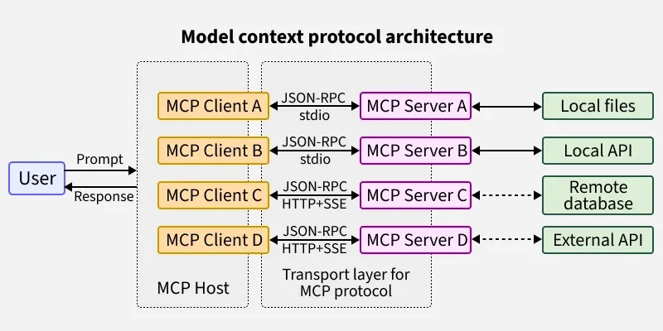
How MCP Works: Architecture

Slide 84
How MCP Works: Data Flow
Agent (MCP client) → sends request via MCP protocol → MCP server (tool/data provider) → server executes tool or returns data → returns response via MCP → agent receives & uses data.
Protocol is transport-agnostic: can work over HTTP, WebSockets, gRPC — flexible across environments
Ensures type-safe, structured data exchange — enables reliable, repeatable integrations, reduces custom API-by-API work.

Slide 85
Advantages of MCP
Scale: MCP servers can be defined and hosted once and used by many AI systems. This capacity limits the need to define access to the same source data, resources and AI tools for multiple generative AI systems.
Data retrieval: Unlike RAG where data retrieval requires preprocessing and vectorizing before query, MCP is dynamic and allows for fluctuations and updates from information sources in real-time.
Complexity: MCP is fairly simple to setup and incorporate into AI applications, as we demonstrate here. You can use config files easily to make an MCP server portable across environments.
Platform-independent: Beyond the fact that you can build MCP servers with Python, TypeScript or other languages, they are also not coupled to a specific LLM solution.
Debugging through a client/server model: The MCP client sends requests to the MCP server, which then fetches the necessary data from various external systems and sources—be it APIs, databases or local files. This structured approach ensures that the AI model receives consistent and relevant context, leading to more accurate and reliable outputs. MCP uses JSON-RPC to encode messages and supports 2 transport mechanisms, stdio and streamable HTTP. In previous iterations of the protocol, it also supported HTTP with server-sent events (SSE)

Slide 86
Why MCP Matters: Benefits & Use-Cases
Makes it easy to build AI agents that are tool-aware and data-aware — can query databases, call APIs, fetch live data, control other services.
Promotes modularity and reusability — same MCP server/tool can be used by different agents, reducing duplication.
Makes agents environment-agnostic and interoperable — easier to integrate into enterprise stacks that rely on diverse tools, databases, services.

Slide 87
How A2A and MCP Complement Each Other

Slide 88
A2A vs MCP: What Each Does (Comparison)
Protocol | Core Purpose | Operates On... | Key Strength
A2A | Agent-to-Agent communication & coordination | Between agents (peer-to-peer) | Collaboration, multi-agent workflows, specialization, coordination (KDnuggets)
MCP | Tool / Data access for agents | Agent ↔ External tools/data | Standardized integration, tool/data access, enabling context & actions (Wikipedia)
A2A = “network cable / messaging bus between agents”, for agent-to-agent info/task exchange.
MCP = “USB-C / universal connector” for agents to reach tools, data, external systems — enabling them to act meaningfully on real-world tasks.

Slide 89
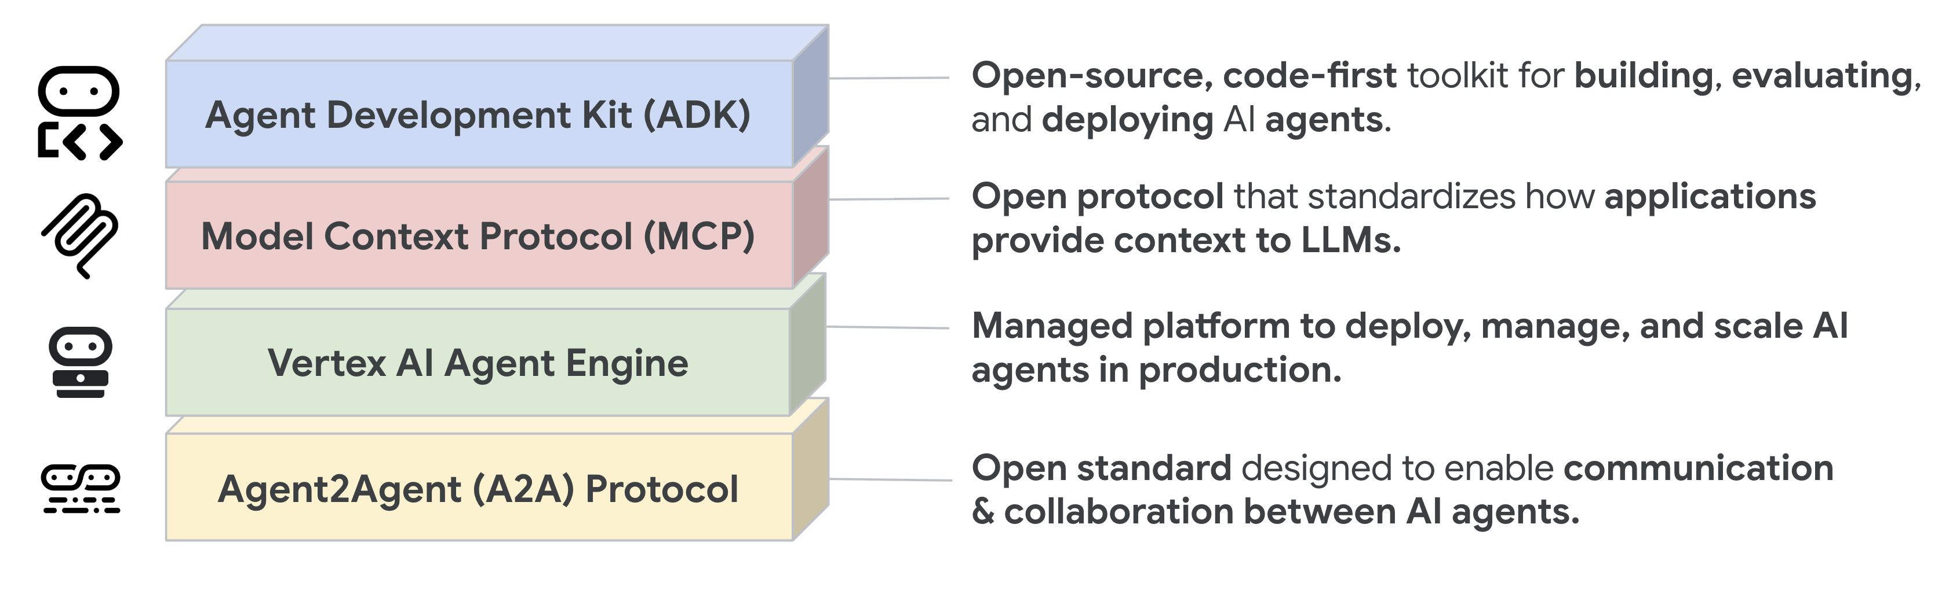
A2A vs MCP: What Each Does (Comparison)

Slide 90
Why Use Both Together?
Multi-agent system where agents collaborate (A2A) AND also need external data/tools (MCP) — combination gives full power: collaboration + context-aware capabilities.
Enables building complex, real-world workflows: e.g. one agent fetches data (via MCP), passes to analysis agent (via A2A), another agent triggers action (via MCP) — all in a coordinated, standardized way.

Slide 91
Example Scenario: Applying A2A + MCP

Slide 92
Scenario Overview
Scenario: Smart Home Management — agents manage weather data, energy prices, devices, and user preferences to optimize home energy consumption.
Agents involved:
Weather Agent
Grid-Price Agent
Device Control Agent
User Preference Agent
Energy Optimization Agent

Slide 93
How Agents Interact: MCP + A2A Flow
Weather Agent uses MCP to fetch weather forecast from external API.
Grid-Price Agent uses MCP to fetch real-time energy price data.
User Preference Agent gathers user’s preferences (from local DB via MCP).
All data passed (via A2A) to Energy Optimization Agent which analyzes and computes optimal device schedule.
Energy Optimization Agent sends instructions (via A2A / MCP) to Device Control Agent to adjust smart devices.
Device Control Agent executes, sends status back; the user sees updated schedule or report.

Slide 94
Benefits of This Setup (Why A2A + MCP helps)
Modular: each agent handles one responsibility (data fetch, optimization, control) — easy to maintain & update.
Scalable: new agents (e.g. Security Agent, Maintenance Agent) can be added without re-architecting entire system.
Real-time & dynamic: agents fetch live data, react to changes (weather, price), adapt schedule.
Interoperable: agents built on different frameworks/tools still communicate via A2A; data/tools via MCP.

Slide 95
What Could Go Wrong & What to Monitor
Data freshness issues: If external APIs fail or data outdated → wrong scheduling decisions
Communication failure: agent discovery / message passing errors — need robust error handling & retries
Conflicting instructions: two agents sending contradictory commands to devices — need coordination/locking mechanism
Security & access control: external APIs, device controls must be authorized, authenticated — protocol-level security important

Slide 96
Summary & Takeaways

Slide 97
Key Concepts Recap
Agentic AI benefits when agents collaborate & specialize
Protocols essential for scalable, interoperable agent ecosystems
A2A: agent-to-agent communication & coordination
MCP: tool/data integration & context-aware capabilities
Combining A2A + MCP gives power: modular, flexible, real-world capable multi-agent systems

Slide 98
When to Use What / Design Advice
Use MCP when agents need external data/tools — good for single agent or small systems needing tool access
Use A2A when you have multiple agents handling different roles/tasks — need collaboration, task delegation, specialization
For complex, real-world systems — design with both: data/tool access + agent collaboration
Always ensure security, error-handling, clear roles, and data governance when integrating agents & external tools

Slide 99
Further Reading & Resources
Article: “Building AI Agents? A2A vs. MCP Explained Simply” — good primer.
Survey: “A survey of agent interoperability protocols: MCP, A2A, ACP, ANP” — deeper conceptual & technical coverage.
Blog: “Agentic AI Protocols: MCP, A2A, and ACP” — practical use-cases & combinations.
https://www.ibm.com/think/topics/agent2agent-protocol#684929709
https://www.ibm.com/think/topics/model-context-protocol#179371084
https://www.geeksforgeeks.org/artificial-intelligence/model-context-protocol-mcp/
https://youtu.be/mFkw3p5qSuA?si=Nv7KawFQh4CjpOGV

Slide 100



Thank You

